Slide 1
UPPER SIXTH ARTS
GEOGRAPHY
Map Analysis 1
Review of Map Reading Principles
Notes:
Good morning, class, and welcome to our geography lesson. I am your geography teacher, Mr Kamdem. Today we are starting Map Analysis 1: Review of Map Reading Principles.

Slide 2
CLASS INFO
Class, Chapter and Duration
Class | Upper Sixth Arts
Chapter | Module 8: Understanding and carrying out statistical techniques, topographic map analysis, fieldwork and project based learning
Duration | 2 periods (2 × 50 minutes)
Notes:
This lesson is for Upper Sixth Arts. It belongs to Module 8: Understanding and carrying out statistical techniques, topographic map analysis, fieldwork and project based learning. We shall need 2 periods to cover it.

Slide 3
IDENTIFICATION
Lesson Identification
Topic | Topographic Map Analysis
Sub-topic | Review of map reading of the first cycle
Lesson | Map Analysis 1: Review of Map Reading Principles
Notions / Concepts | Topographic map, conventional sign, key, scale, grid reference, contour, spot height.
Syllabus focus | Conventional signs and symbols and the key; scales and map measurements; principles of contours.
Competence | Learners are able to read signs, measure distances and give grid references on a topographic map.
Notes:
Our topic is Topographic Map Analysis, and the sub-topic is Review of map reading of the first cycle. The key notions we shall use today are: topographic map, conventional sign, key, scale, grid reference, contour, spot height. At the end, you should be able to do this: learners are able to read signs, measure distances and give grid references on a topographic map.

Slide 4

HOMEWORK CORRECTION
Correction of the Homework
Question (Further Study 1: Contrast in Development within Cameroon):
Compare your region with Douala using three indicators and suggest two projects.
Notes:
Before we start the new lesson, let us correct the homework I gave you at the end of Further Study 1: Contrast in Development within Cameroon. The question was: Compare your region with Douala using three indicators and suggest two projects. Take out your exercise books.

Slide 5
HOMEWORK CORRECTION
Correction: Possible Answer
Example (North vs Douala): literacy about 40 % vs 90 %; electricity access about 30 % vs 90 %; industrial jobs few vs many. Projects: tar the rural roads and build a vocational training centre.
Notes:
Here is a good answer. Example (North vs Douala): literacy about 40 % vs 90 %; electricity access about 30 % vs 90 %; industrial jobs few vs many. Projects: tar the rural roads and build a vocational training centre. Compare it with your own answer and correct your work in red.

Slide 6
LESSON PLAN
Lesson Plan
Correction of the homework
Objectives and recall
Real-life situation and action to take
Learning activities
Board summary
Evaluation, remediation and homework
Notes:
Here is the plan of our lesson today. First, we shall correct the homework. Then we shall look at the objectives and recall what you already know. After that, we shall study a situation from real life and the action to take, and do the learning activities. Finally, we shall copy the board summary, do the evaluation and the remediation, and I will give you the homework.

Slide 7
OBJECTIVES
Objectives
By the end of this lesson, you should be able to:
Use the key to identify conventional signs.
Measure distances with the scale.
Notes:
Take your time to copy this part; we will continue together.

Slide 8
OBJECTIVES
Objectives (continued)
Give six-figure grid references and read contours.
Notes:
By the end of this lesson, you should be able to do three things. Number 1: use the key to identify conventional signs. Number 2: measure distances with the scale. Number 3: give six-figure grid references and read contours.

Slide 9
PREVIOUS KNOWLEDGE
Previous Knowledge
A map is a drawing of the Earth on a flat surface.
The key explains the symbols.
Notes:
Let us first remember what you already know. A map is a drawing of the Earth on a flat surface. The key explains the symbols. Keep this in mind, because we shall build on it today.

Slide 10
REAL-LIFE SITUATION
Situation in Real Life
The class receives a 1:50,000 map extract of an area near Mbé. The teacher asks them to find the village, measure the road from A to B and give the height of the highest hill.
Notes:
Listen carefully to this situation from real life. The class receives a 1:50,000 map extract of an area near Mbé. The teacher asks them to find the village, measure the road from A to B and give the height of the highest hill. Think about it, because I am going to ask you some questions.

Slide 11
REAL-LIFE SITUATION
Situation: Question 1
What is the problem in the situation?
Notes:
Question 1: What is the problem in the situation? Think for a moment, then raise your hand to answer.

Slide 12
REAL-LIFE SITUATION
Answer
The class must read and measure on a map.
Notes:
Good. The class must read and measure on a map.

Slide 13
REAL-LIFE SITUATION
Situation: Question 2
What helps to identify symbols?
Notes:
Question 2: What helps to identify symbols? Think for a moment, then raise your hand to answer.

Slide 14
REAL-LIFE SITUATION
Answer
The key (legend).
Notes:
Good. The key (legend).

Slide 15
REAL-LIFE SITUATION
Situation: Question 3
What shows the height of land?
Notes:
Question 3: What shows the height of land? Think for a moment, then raise your hand to answer.

Slide 16
REAL-LIFE SITUATION
Possible Answer
Contours and spot heights.
Notes:
Good. Contours and spot heights.

Slide 17
ACTION TO TAKE
Action to Take
Read every map carefully using its key, scale and grid.
Notes:
From this situation, the action we are working towards in this lesson is the following: read every map carefully using its key, scale and grid.

Slide 18
JUSTIFICATION
Justification of the Lesson
This lesson revises the basic skills needed for all map analysis.
Notes:
Why is this lesson important for you? This lesson revises the basic skills needed for all map analysis.

Slide 19

1. SIGNS AND KEY
Activity 1
Conventional signs.
Notes:
Activity 1. Look carefully at this diagram: conventional signs. Observe every detail before I ask the question.

Slide 20
1. SIGNS AND KEY
Activity 1: Question
Why are conventional signs used on maps?
Notes:
Here is the question for Activity 1: Why are conventional signs used on maps? Take one minute to think and write your answer in your rough notebook.

Slide 21
1. SIGNS AND KEY
Activity 1: Answer
To show many features in a small space in a standard way.
Notes:
Let us check the answer together. To show many features in a small space in a standard way.

Slide 22
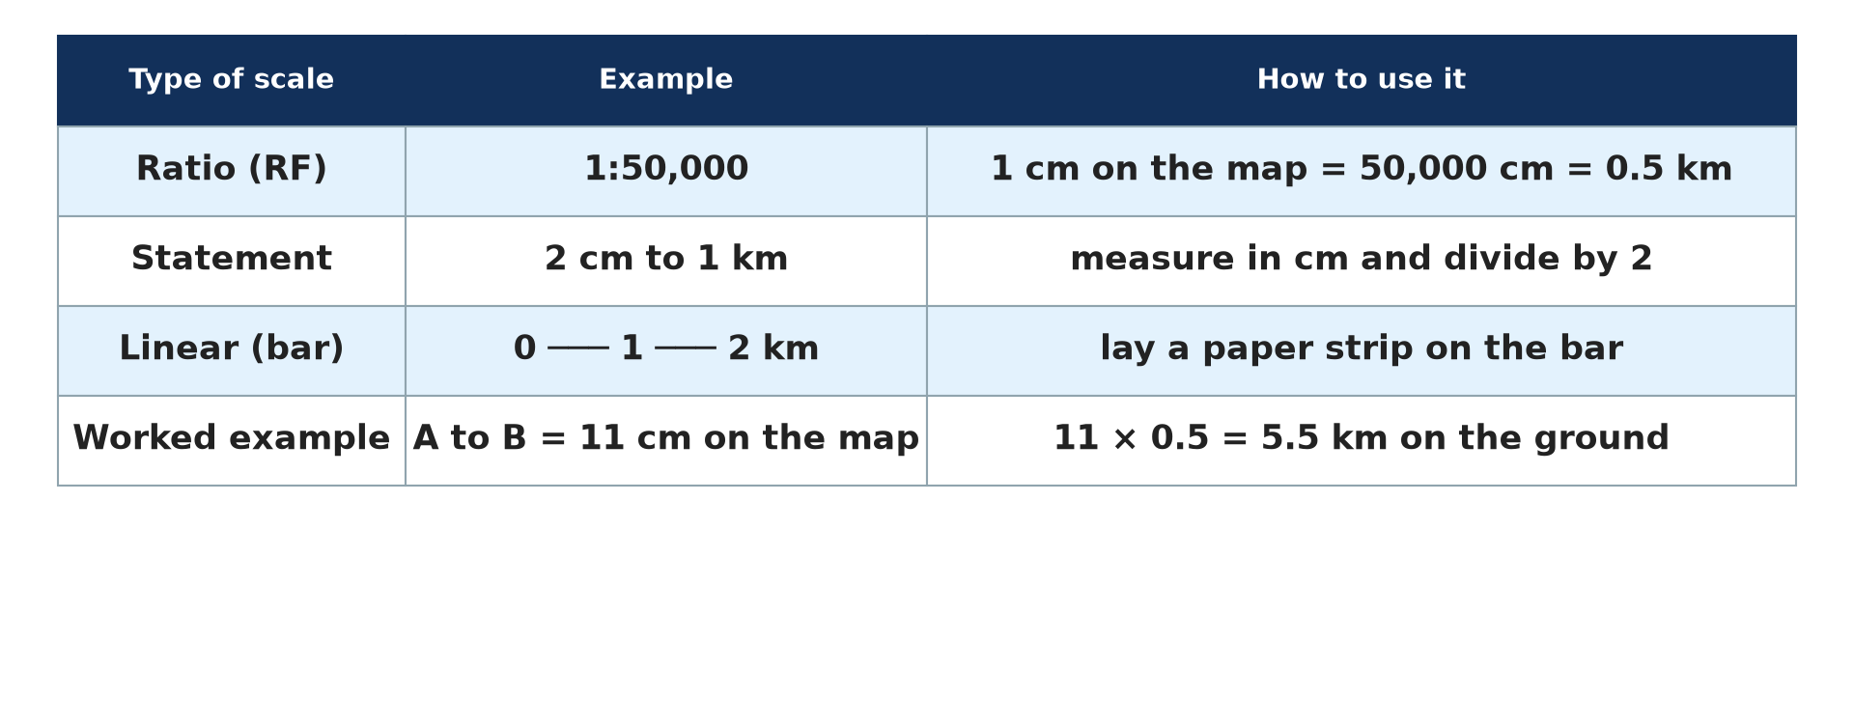
2. SCALE AND MEASUREMENT
Activity 2
Types of scale.
Notes:
Activity 2. Look carefully at this diagram: types of scale. Observe every detail before I ask the question.

Slide 23
2. SCALE AND MEASUREMENT
Activity 2: Question
On a 1:50,000 map, A to B measures 9 cm. What is the real distance?
Notes:
Here is the question for Activity 2: On a 1:50,000 map, A to B measures 9 cm. What is the real distance? Take one minute to think and write your answer in your rough notebook.

Slide 24
2. SCALE AND MEASUREMENT
Activity 2: Answer
9 × 0.5 = 4.5 km.
Notes:
Let us check the answer together. 9 × 0.5 = 4.5 km.

Slide 25
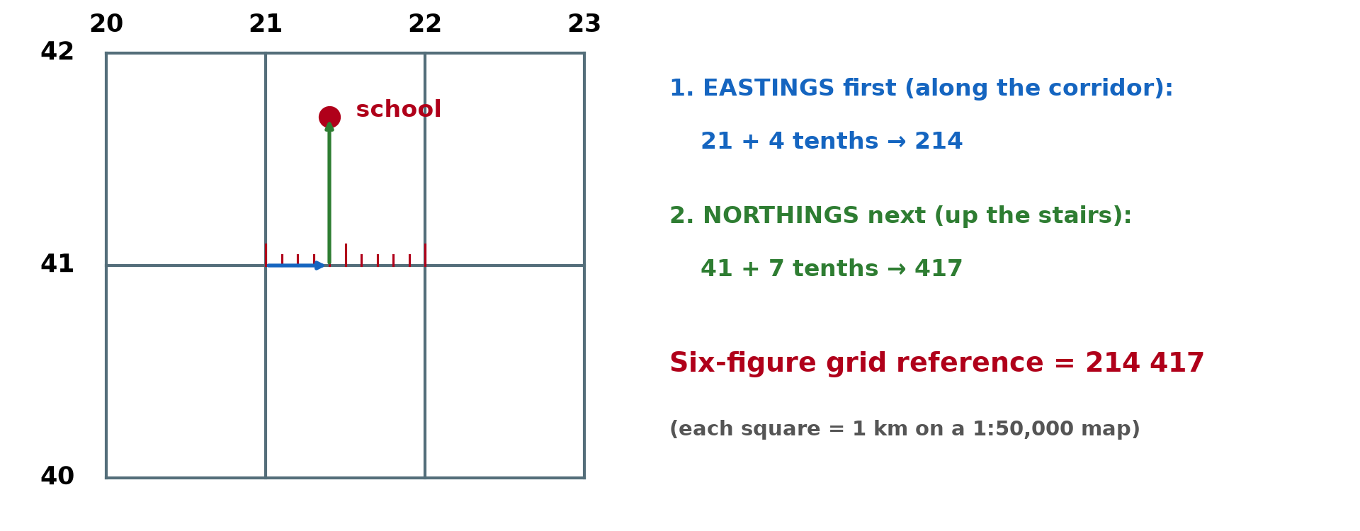
2. GRID REFERENCES
Activity 3
A six-figure grid reference.
Notes:
Activity 3. Look carefully at this diagram: a six-figure grid reference. Observe every detail before I ask the question.

Slide 26
2. GRID REFERENCES
Activity 3: Question
Which comes first in a grid reference, eastings or northings?
Notes:
Here is the question for Activity 3: Which comes first in a grid reference, eastings or northings? Take one minute to think and write your answer in your rough notebook.

Slide 27
2. GRID REFERENCES
Activity 3: Answer
Eastings first, then northings.
Notes:
Let us check the answer together. Eastings first, then northings.

Slide 28
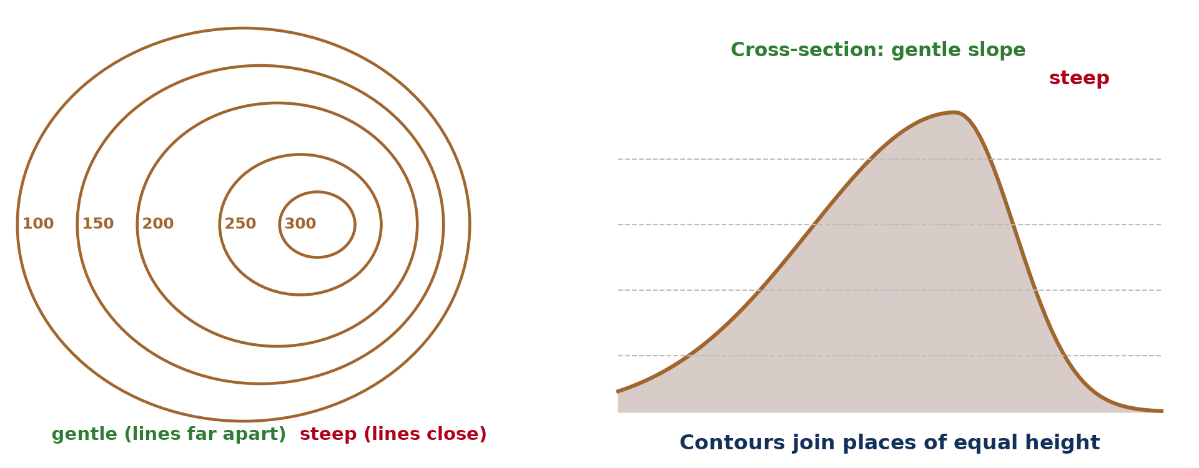
3. PRINCIPLES OF CONTOURS
Activity 4
Contours and slopes.
Notes:
Activity 4. Look carefully at this diagram: contours and slopes. Observe every detail before I ask the question.

Slide 29
3. PRINCIPLES OF CONTOURS
Activity 4: Question
What do closely spaced contours show?
Notes:
Here is the question for Activity 4: What do closely spaced contours show? Take one minute to think and write your answer in your rough notebook.

Slide 30
3. PRINCIPLES OF CONTOURS
Activity 4: Answer
A steep slope.
Notes:
Let us check the answer together. A steep slope.

Slide 31
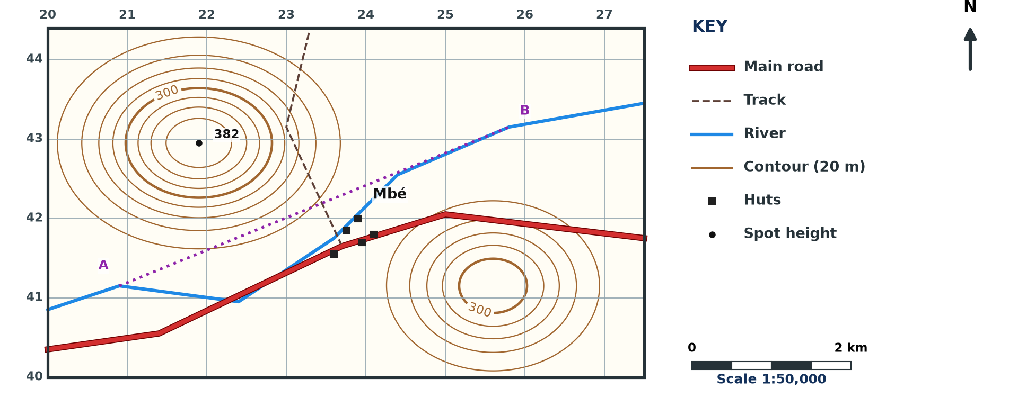
3. APPLICATION
Activity 5
A map extract (invented, 1:50,000).
Notes:
Activity 5. Look carefully at this diagram: a map extract (invented, 1:50,000). Observe every detail before I ask the question.

Slide 32
3. APPLICATION
Activity 5: Question
Give the height of the spot height and the direction of Mbé from it.
Notes:
Here is the question for Activity 5: Give the height of the spot height and the direction of Mbé from it. Take one minute to think and write your answer in your rough notebook.

Slide 33
3. APPLICATION
Activity 5: Answer
382 m; Mbé is south-east of the spot height.
Notes:
Let us check the answer together. 382 m; Mbé is south-east of the spot height.

Slide 34
BOARD SUMMARY
Board Summary
Topic: Topographic Map Analysis
Sub-topic: Review of map reading of the first cycle
Map Analysis 1: Review of Map Reading Principles
Notes:
Now we are going to copy the board summary. Write the title and the headings neatly in your notebooks. I will give you enough time for each slide, so do not rush.

Slide 35
BOARD SUMMARY
DEFINITIONS
The key terms of this lesson are defined as follows:
Topographic map: It is a detailed map that shows relief, drainage, vegetation and human features. In Cameroon, most are at 1:50,000 or 1:200,000.
Notes:
Let us copy the definitions. The key terms of this lesson are defined as follows. On this slide we have Topographic map. Write each point on a new line, with the key term first, and explain it in your own words when we revise. When you finish, we go to the next slide.

Slide 36
BOARD SUMMARY
DEFINITIONS (continued)
Contour: It is a line joining places of the same height above sea level. Contours show relief on a map.
Notes:
We continue with the definitions. On this slide we have Contour. Write each point on a new line, with the key term first, and explain it in your own words when we revise.

Slide 37
BOARD SUMMARY
1. Conventional Signs and the Key
Map features are shown as follows:
Conventional signs: They are standard symbols, colours and letters that represent features on a map. They show many features in a small space.
Notes:
Let us copy Conventional Signs and the Key. Map features are shown as follows. On this slide we have Conventional signs. Write each point on a new line, with the key term first, and explain it in your own words when we revise. When you finish, we go to the next slide.

Slide 38
BOARD SUMMARY
1. Conventional Signs and the Key (continued)
Key: It is the list that explains the meaning of each sign on the map. It must always be read before the map is analysed.
Notes:
We continue with Conventional Signs and the Key. On this slide we have Key. Write each point on a new line, with the key term first, and explain it in your own words when we revise.

Slide 39
BOARD SUMMARY
1. Conventional Signs and the Key
Illustration: conventional signs
Notes:
Now draw this illustration in your notebook: conventional signs. Give it a title and label it clearly.

Slide 40
BOARD SUMMARY
2. Scales and Map Measurements
Maps are measured using the following tools:
Scale: It is the ratio between a distance on the map and the real distance on the ground. It can be a statement, a representative fraction (1:50,000) or a linear scale.
Notes:
Let us copy Scales and Map Measurements. Maps are measured using the following tools. On this slide we have Scale. Write each point on a new line, with the key term first, and explain it in your own words when we revise. When you finish, we go to the next slide.

Slide 41
BOARD SUMMARY
2. Scales and Map Measurements (continued)
Distance and area: Straight distances are measured with a ruler and curved ones with a thread or paper strip, then converted with the scale. On a 1:50,000 map, 1 cm = 0.5 km and a 2 cm grid square = 1 km².
Notes:
We continue with Scales and Map Measurements. On this slide we have Distance and area. Write each point on a new line, with the key term first, and explain it in your own words when we revise. When you finish, we go to the next slide.

Slide 42
BOARD SUMMARY
2. Scales and Map Measurements (continued)
Grid references: A six-figure reference gives eastings first and then northings. The third and sixth figures are tenths of the grid square.
Notes:
We continue with Scales and Map Measurements. On this slide we have Grid references. Write each point on a new line, with the key term first, and explain it in your own words when we revise.

Slide 43
BOARD SUMMARY
2. Scales and Map Measurements
Illustration: a six-figure grid reference
Notes:
Now draw this illustration in your notebook: a six-figure grid reference. Give it a title and label it clearly.

Slide 44
BOARD SUMMARY
3. Principles of Contours
Contours follow these principles:
Principles: Contours never cross and are drawn at a fixed vertical interval. Heights are written on index contours.
Notes:
Let us copy Principles of Contours. Contours follow these principles. On this slide we have Principles. Write each point on a new line, with the key term first, and explain it in your own words when we revise. When you finish, we go to the next slide.

Slide 45
BOARD SUMMARY
3. Principles of Contours (continued)
Slopes: Close contours show steep slopes and widely spaced contours show gentle slopes. Spot heights and trigonometrical stations give exact heights.
Notes:
We continue with Principles of Contours. On this slide we have Slopes. Write each point on a new line, with the key term first, and explain it in your own words when we revise.

Slide 46
BOARD SUMMARY
3. Principles of Contours
Illustration: contours and slopes
Notes:
Now draw this illustration in your notebook: contours and slopes. Give it a title and label it clearly.

Slide 47
FORMATIVE EVALUATION
Evaluation 1
Convert 1:50,000 into a statement scale.
Notes:
Now let us check what you have understood. Question 1: Convert 1:50,000 into a statement scale. Answer in your exercise book.

Slide 48
FORMATIVE EVALUATION
Expected Answer
2 cm represent 1 km.
Notes:
The expected answer is: 2 cm represent 1 km. If you got it right, well done.

Slide 49
FORMATIVE EVALUATION
Evaluation 2
State two principles of contours.
Notes:
Now let us check what you have understood. Question 2: State two principles of contours. Answer in your exercise book.

Slide 50
FORMATIVE EVALUATION
Expected Answer
They join equal heights and never cross.
Notes:
The expected answer is: they join equal heights and never cross. If you got it right, well done.

Slide 51
REMEDIATION
Remediation
Fill in the blanks:
The ______ explains map symbols.
Eastings are read ______.
Close contours show a ______ slope.
Notes:
For those who need more practice, fill in the blanks in your exercise book. The answers are: number 1, key; number 2, first; number 3, steep.

Slide 52
HOMEWORK
Homework
Draw a map of your school with a key, a scale and a north arrow.
Notes:
For your homework: Draw a map of your school with a key, a scale and a north arrow. We shall correct it at the beginning of our next lesson.

Slide 53
NEXT LESSON
Next Lesson
Our next lesson will be on:
Map Analysis 2: Remote Sensing, Aerial Photographs and GIS
Notes:
Our next lesson will be on Map Analysis 2: Remote Sensing, Aerial Photographs and GIS. Thank you for your attention, and see you next time.

Slide 54
BILINGUAL GAME
Bilingual Game (Jeu Bilingue)
English | Français
Map | La carte
Key | La légende
Scale | L'échelle
Contour | La courbe de niveau
Grid reference | Les coordonnées
Spot height | Le point coté
Notes:
Let us play the bilingual game. I say a word in English, and you give me the French word. Then we do the reverse.

Slide 55
LOGBOOK
Official Logbook (1/2)
Module / Topic | Topographic Map Analysis
Lesson Title | Map Analysis 1: Review of Map Reading Principles
Expected Learning Outcomes | Use the key to identify conventional signs. Measure distances with the scale. Give six-figure grid references and read contours.
Competence | Learners are able to read signs, measure distances and give grid references on a topographic map.
Notes:
I record this information in the official logbook of the class after the lesson.

Slide 56
LOGBOOK
Official Logbook (2/2)
Matter Taught | DEFINITIONS; Conventional Signs and the Key; Scales and Map Measurements; Principles of Contours.
Evaluation | Formative evaluation and remediation exercise.
Homework | Draw a map of your school with a key, a scale and a north arrow.
Enrolment / Present / Absent | ____ / ____ / ____
Achievement | To be completed after the lesson.
Notes:
I complete the second page of the logbook: the matter taught, the evaluation, the homework and the attendance.

Slide 57
TEACHER'S NOTE
Teacher's Note
Timing: Homework correction, plan, objectives 8 min | Recall, situation, action 10 min | 5 activities 30 min | Board summary (copying) 30 min | Evaluation, remediation 10 min | Homework, next lesson 5 min | Logbook 7 min
Without the projector (Activity 1): draw five signs.
Without the projector (Activity 2): convert scales.
Without the projector (Activity 3): give the reference of a point.
Without the projector (Activity 4): compare spacing.
Without the projector (Activity 5): read the extract.
Notes:
This slide is for me, the teacher: it gives the timing of the lesson and what to do if the projector is not available.

Slide 58
REFERENCES
References
National Geography Syllabus, MINESEC/IGE/IP-SS, 2019 — Module 8 (Practical Geography).
Diagrams and animations: drawn for this lesson (Geography Department).
Notes:
These are the references and picture credits used to prepare this lesson.

